Slide 1
SC-205
DISCRETE MATHEMATICS

Slide 2
ZEEL GHORI
202201287
YASH MEHTA
S.E.E.D
202201309
AKSHAT JINDAL
202201299
JAYESH PADIYA
202201358

Slide 3
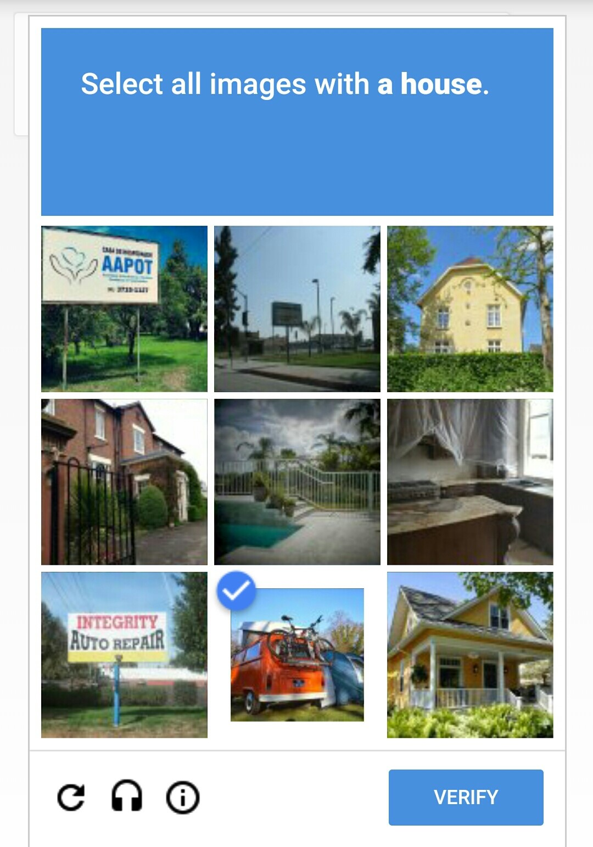
INTRODUCTION

Slide 4
The Origin of S.E.E.D
A
The process of thinking started when we realized that cyber security is one of the main growing concern in this modern world.
B
Cyber Security mainly consists of a username-password and a captcha. Though the username-password system is working perfectly, the captcha system might just not be so efficient
C
After figuring out a problem that needs to be resolved, all that was left was to find a solution with the knowledge we have. The result, as we present to you, is S.E.E.D

Slide 5
INTRODUCTION
With the rise in current digitalization, cyber security is the need of the hour. Data and information has to be kept safe from unwanted entities.
With the current world going digital in every phase of life, every chore of the human life is now computerized.
S.E.E.D or Security Enhancement through Encrypted Designing helps in increasing the security online. It protects the user from unwanted guests.
A concept inspired from the traditional use of captcha, S.E.E.D provides an alternative layer of security for its users with a new implimentation of Discrete Mathematics.

Slide 6
PROBLEM
The current system of online security consists of username-password along with a captcha. The captcha, there for human verification can, to some extent, prevent bots from entering. But even they fail when it comes to preventing unwanted people or highly intelligent bots from getting access to classified information.
Even though captcha is a very efficient way of keeping bots at bay, it has unfortunately not developed enough with time to prevent new bots with AI or ML skills from getting access or to prevent hackers from getting access. This can be done with the help of our solution.
In order to protect our data online, there is a need for something more difficult to decode. Something that can not be easily figured out by a bot or a hacker. This would act as another layer forming a two way authentication sort of system of security.

Slide 7

DESIGN

Slide 8
The solution is inspired from the original captcha concept. It is a derivation of the concept, but not one which only identifies bots but also, the person.
A standard key is selected for the filling of the the matrix in the form a hash table. For a matrix of nxn, a small matrix of total n cells is taken for the hashing process
S.E.E.D works on the principle of hashing. A concept that is based on a modulus operator, functioned by a key.
The cells can then be filled with consequent colours by putting the values in the key from 0 to n - 1. This process can be repeated by changing the constants of the key for the next small matrix
S.E.E.D designs a matrix, similar to the one made by the captcha, by taking the size of the matrix and the colours used as inputs from the user.
This way we can complete the whole matrix. The company can decide which 3-4 small matrix are to be selected by the user to go forward

Slide 9
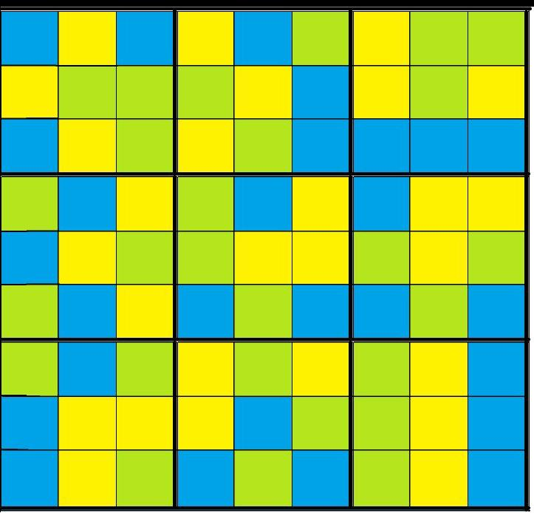
0 | 1 | 2 | 0 | 1 | 2 | 0 | 1 | 2
3 | 4 | 5 | 3 | 4 | 5 | 3 | 4 | 5
6 | 7 | 8 | 6 | 7 | 8 | 6 | 7 | 8
0 | 1 | 2 | 0 | 1 | 2 | 0 | 1 | 2
3 | 4 | 5 | 3 | 4 | 5 | 3 | 4 | 5
6 | 7 | 8 | 6 | 7 | 8 | 6 | 7 | 8
0 | 1 | 2 | 0 | 1 | 2 | 0 | 1 | 2
3 | 4 | 5 | 3 | 4 | 5 | 3 | 4 | 5
6 | 7 | 8 | 6 | 7 | 8 | 6 | 7 | 8

Slide 10


FILLING OF HASH TABLE
HASHING FORMULA
VALUES OF N | COLOUR
0 | blue(B)
1 | yellow(Y)
2 | blue(B)
3 | yellow(Y)
4 | green(G)
5 | green(G)
6 | blue(B)
7 | yellow(Y)
8 | green(G)
B | Y | B
Y | G | G
B | Y | G

Slide 11
VALUES OF N | COLOUR
. | .
. | .
. | .
0 | green(G)
1 | yellow(Y)
2 | blue(B)
3 | green(G)
4 | yellow(Y)
5 | blue(B)
6 | green(G)
7 | yellow(Y)
8 | blue(B)
B | Y | B | Y | B | G | Y | G | G
Y | G | G | G | Y | B | Y | G | Y
B | Y | G | Y | G | B | B | B | B
G | B | Y | G | B | Y | B | Y | Y
B | Y | G | G | Y | Y | G | Y | G
G | B | Y | B | G | B | B | G | B
G | B | G | Y | G | Y | G | Y | B
B | Y | Y | Y | B | G | G | Y | B
B | Y | G | B | G | B | G | Y | B

Slide 12
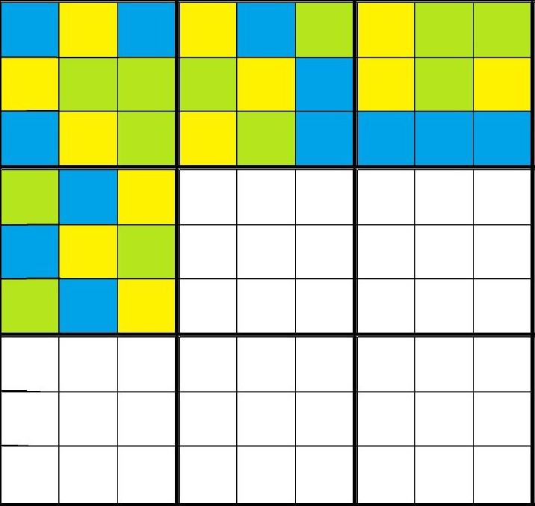
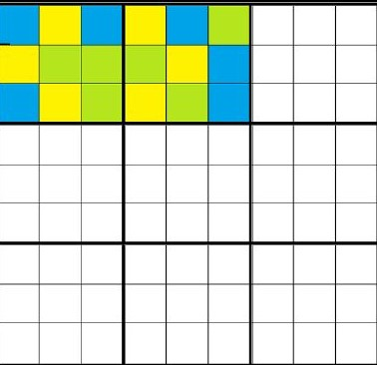
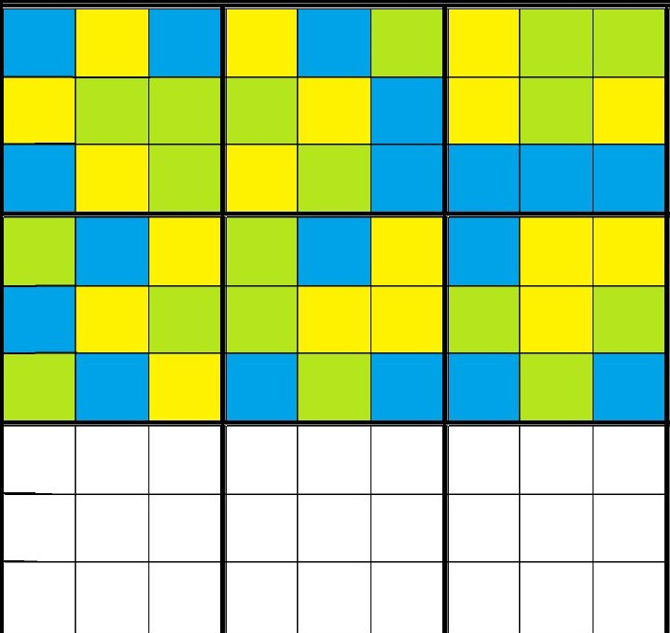

Slide 13
COMMERCIALISATION
We can commercialize this product by selling it to various companies, industries, start ups
As the whole world is going digital, cyber
security is something that everyone in the world can take benefit of.
We can further extend it to the common public as every individual person also requires high level of security

Slide 14
SCOPE OF IMPROVEMENT
User product interaction
Public based concept
This product can also be improved by Encryption. We can provide the key for hashing in encrypted form which the user could manipulate, giving the user a choice to get a design of their liking.
We can provide a two way authentication code, one being the username and the password of the user and other being the matrix formed by S.E.E.D. It can also be expanded to cater the needs of the individual person.
Image S.E.E.D
Pixel art form
Another way, can be the use of images that can also be taken from the user. This would give the S.E.E.D matrix an extra visual appeal to the user whilst performing the same function
If we are able to figure out a key, such that we can traverse through the different pixels on the screen, then this concept can have a variety of application. It will make final matrix very attractive and thus we can use S.E.E.D for designing purpose also.

Slide 15
Bibliography
A
The Use and Working of Captcha
https://securityescape.com/how-does-an-image-captcha-work/
B
Concept of Hash Tables
https://www.youtube.com/watch?v=zeMa9sg-VJM
C
A special thanks to Yashvi Makwana (202203070) for advisory on the LaTeX file

Slide 16
THANK
YOU

